Slide 1
Art Auction Price
1106 Sang-woo Park
1609 Woo-Jin Shim

Slide 2
Abstract
Can we predict the price of an art piece sold at auction?
- What features make value on it?
- Artist? Size of art piece? Auction house’s estimate
Data science is used to develop a model and predict the sell price.

Slide 3
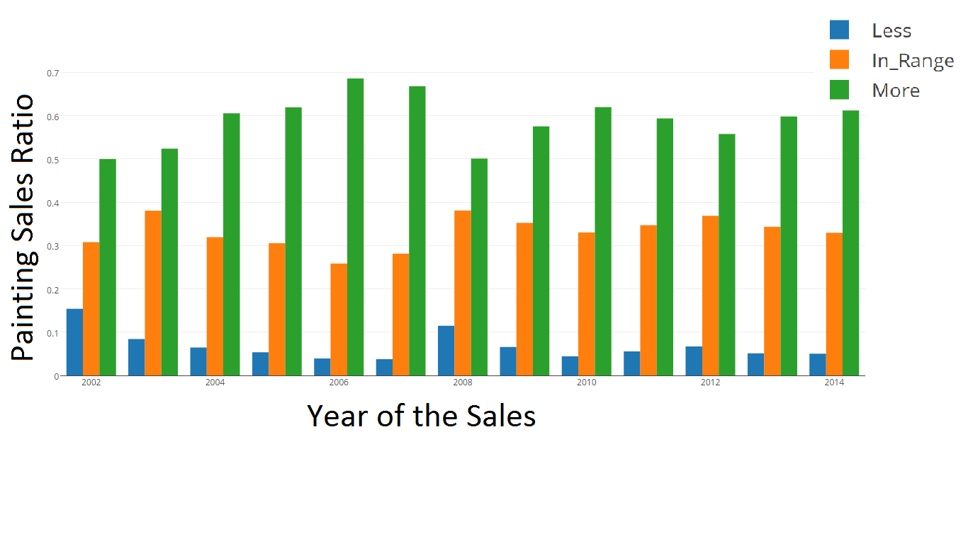
How data science is used in the presentation-Factors
Factors that determine auction price
- Painting features
- Artist features
- Image features
They observed…
- Final price year-wise trend
- Accuracies of auction estimate
Results: Height, Width, Auction house, Premium, Low/High estimate, significance, Gravitas, Celebrity, Fame are important factors.
<Ref. Bhavya Agarwal, “What Will The Hammer Price Be?”>

Slide 4
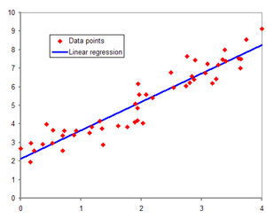
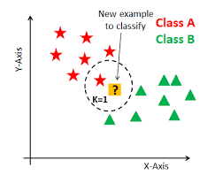
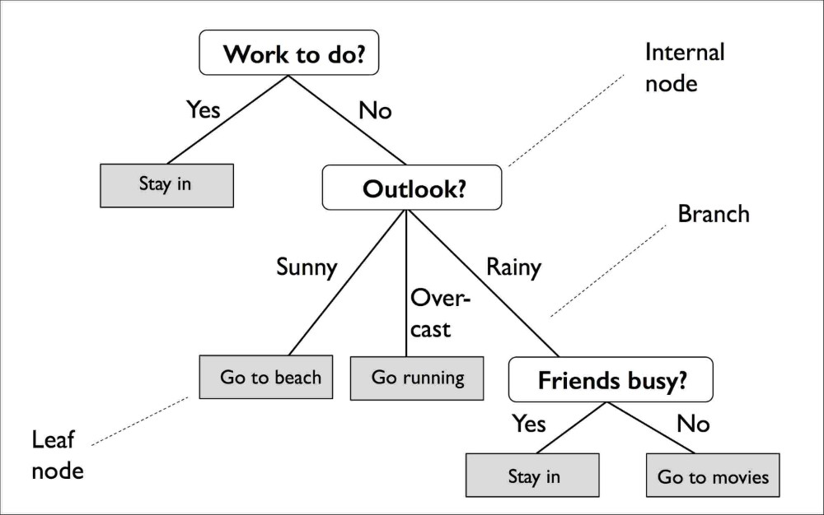
How data science is used in the presentation-Advanced models
Linear Regression (LR)
K-Nearest Neighbor algorithm (KNN)
Decision Tree regression (DT)
→ LR had the biggest accuracy, comparing mean and median errors.

Slide 5

Application to real case
Their prediction: ￡32.8M
Finally sold price: ￡27M
(Total price￡30.3M, including premium)
→ The prediction was accurate!
<Rome, From Mount Aventine>
Joseph Mallord William Turner

